Slide 1

Design and Testing II
Creation and Edition of Chapters
Angel Delgado Luna

Slide 2
Index
UML. Domain Model.
01
Repository and Service Implementation
02
Controller
03
Testing Cases
04

Slide 3
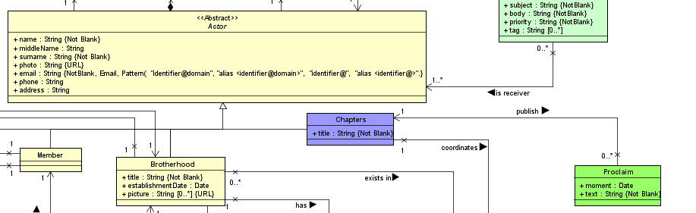

UML. Domain Model.

Slide 4
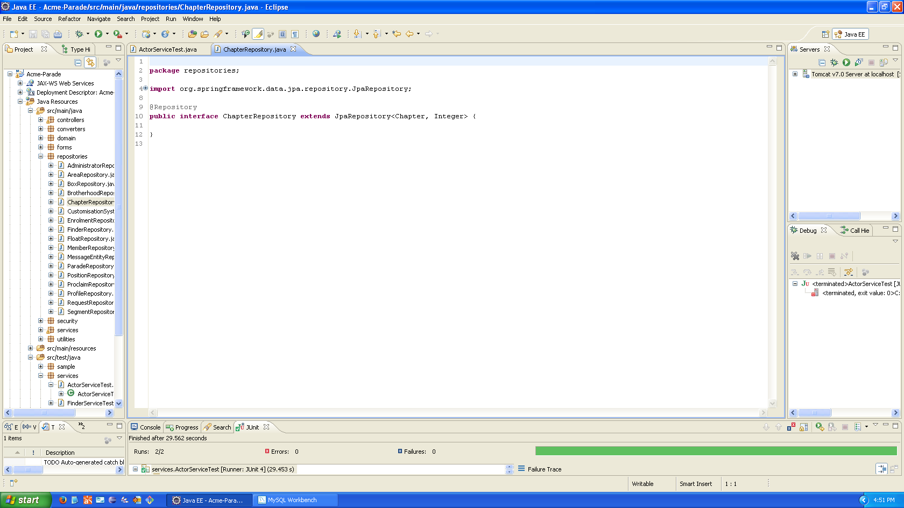
Repository and Services Implementation

Slide 5
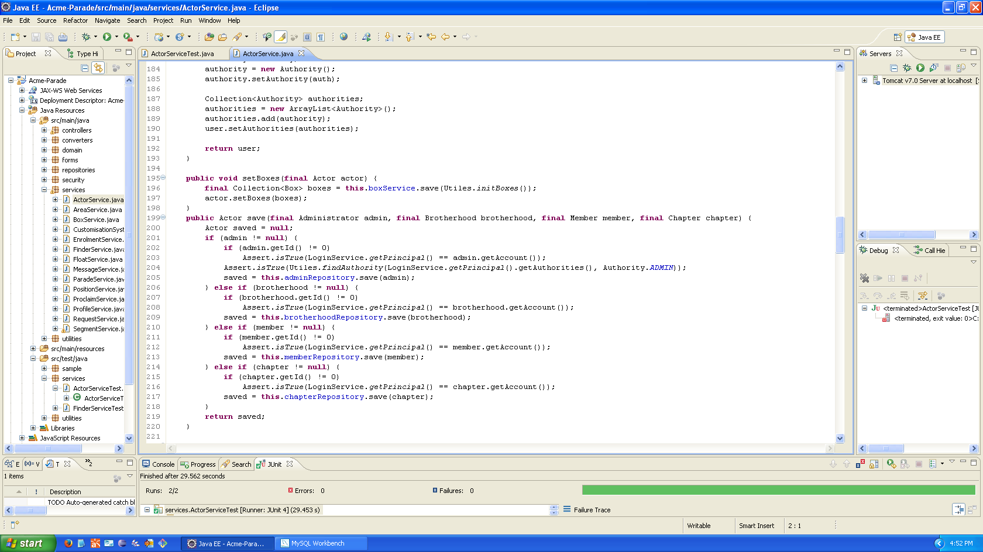
Repository and Service Implementation

Slide 6
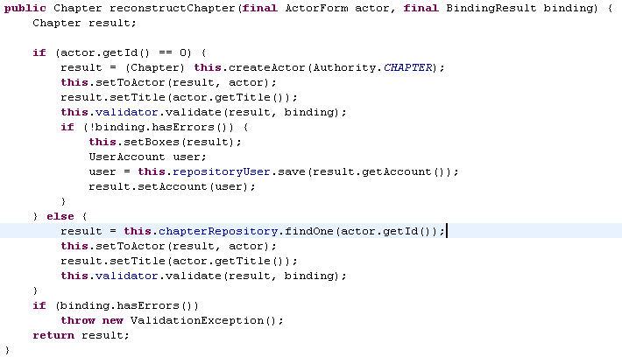
Reconstruct

Slide 7

Controller

Slide 8
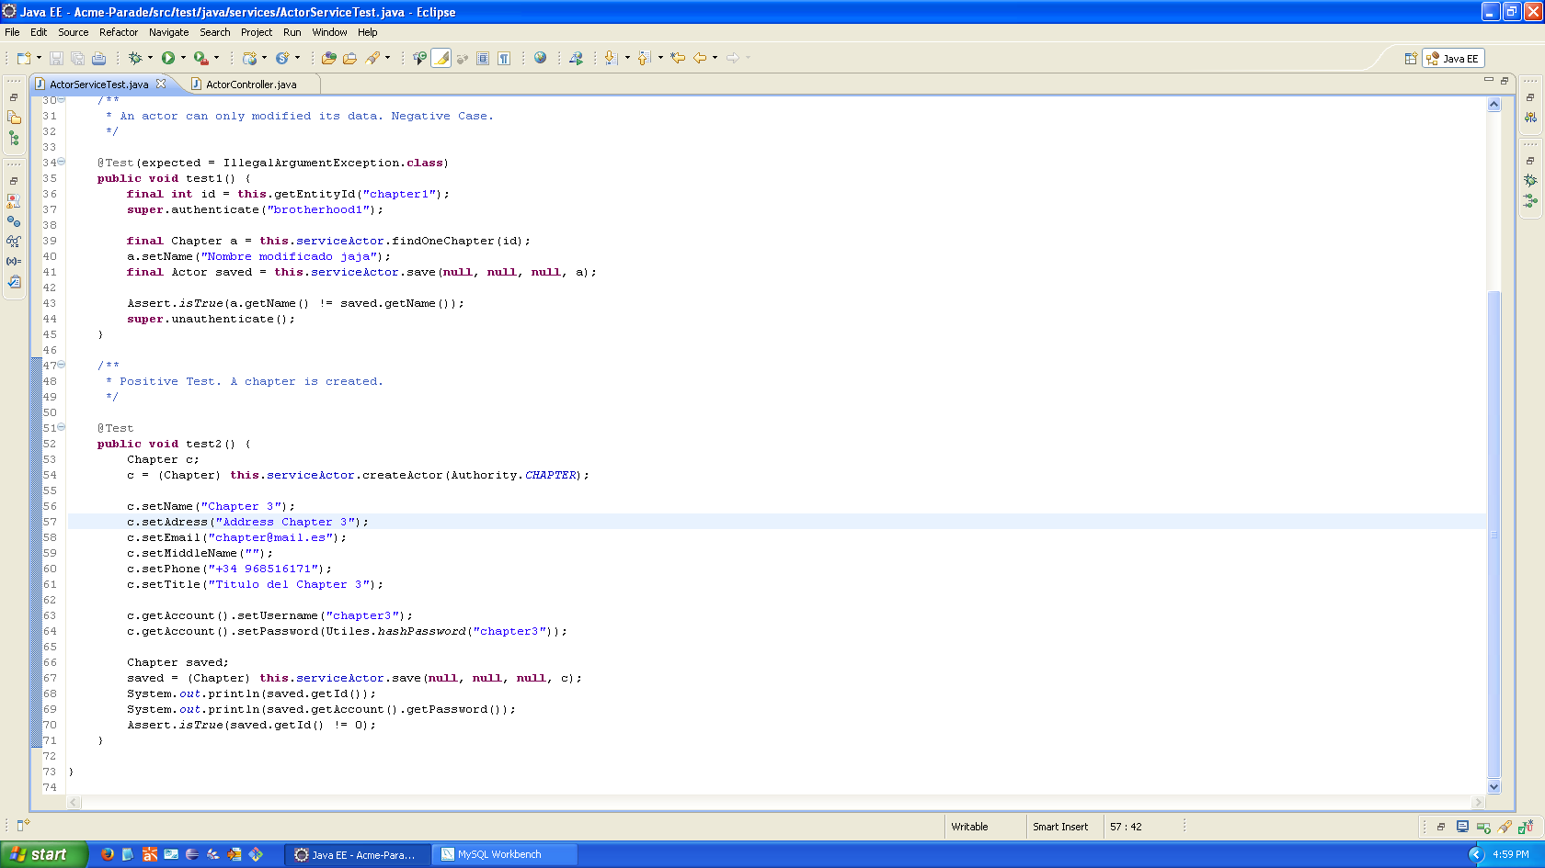

Testing Cases Positive Case

Slide 9

Testing Cases Negative Case

Slide 10

Thanks for your attention! Questions?

